Slide 1


Slide 2

Learning Target
Define Marketing
What is the Marketing Concept
Wants Versus Needs

Slide 3

True or False, If you build it they will come?

Slide 4


If you open a business, say a restaurant, you slap a name on it, build a location, and everyone will just automatically come because you created a business?
Discuss why or why not at your tables and enter into your activity packet.
We will share in class

Slide 5

Do Now
What comes to mind when you hear the word “marketing”?

Slide 6

Advertisements?
Selling products?
Commercials?
Billboards?

Slide 7

Marketing is more than just commercials or billboards. While advertisements play a role in marketing, the whole concept encompasses a broader range of activities

Slide 8

Definition of Marketing
Marketing: the process of creating, communicating, and delivering value to customers through products that customers WANT and NEED
It's about understanding customer needs, designing products that meet those needs, and making sure customers know about them

Slide 9
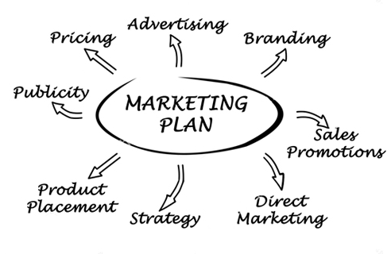
Marketing
Marketing includes (to name a few)
Naming/Branding your business
Creating/Purchasing your products
Advertising
Building websites, social media etc.
Pricing
Publicity
Product Placement

Slide 10

While we know a business is started to earn a profit, business owners need to understand the Concept of why they exist, or the reason for a company’s existence.
A business exists to meet the wants and needs of customers while meeting the objectives of the company.

Slide 11
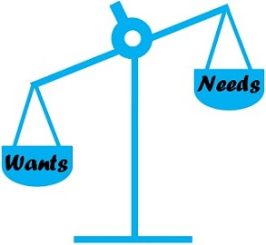
What is the Marketing Concept?
The Marketing Concept: the idea that companies should analyze the needs and wants of their customers, and then make decisions to satisfy those needs better than the competition in an effort to earn a profit

Slide 12


Quick Write Activity
What is the difference between a need and a want? Enter your answer into the Quick Write Activity section of the packet. If missing, enter in blank space on the bottom of page 8

Slide 13


What is a Need?
Need: A need is a basic unit of survival. It is something that a person cannot live without
- In marketing it is what I must purchase before anything else as I need it to survive
Examples of needs include:
water, food, shelter

Slide 14




What is a Want?
Want: A want is something that we would like to have, but we can live without it
Examples of wants include video games, fancy cars, and ice cream

Slide 15

Summary
Marketing is the process of
creating, communicating, and delivering products (goods & services) that customers WANT and NEED

Slide 16

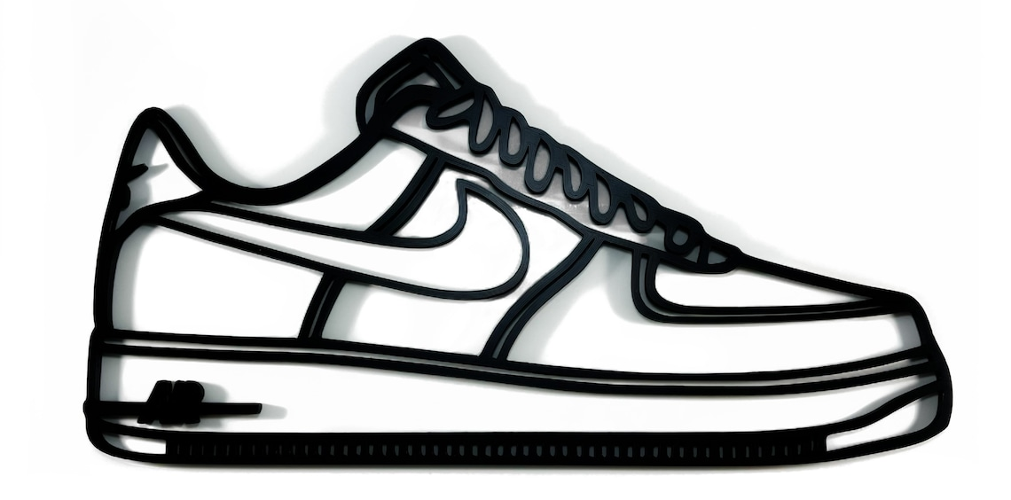
Activity: Let’s Go Shopping!
Directions: Go to Amazon’s website and make a list of two items that would be considered needs for you, and four items that would be considered wants for you. Next to each item, briefly explain why it would be considered a need or a want. Enter your answers into your activity packet
For each item, be sure to list what it is, its name, and its price
For example: Sneakers, Nike Air Force 1, $124
Then list if it is a want or a need and why?

